Slide 1
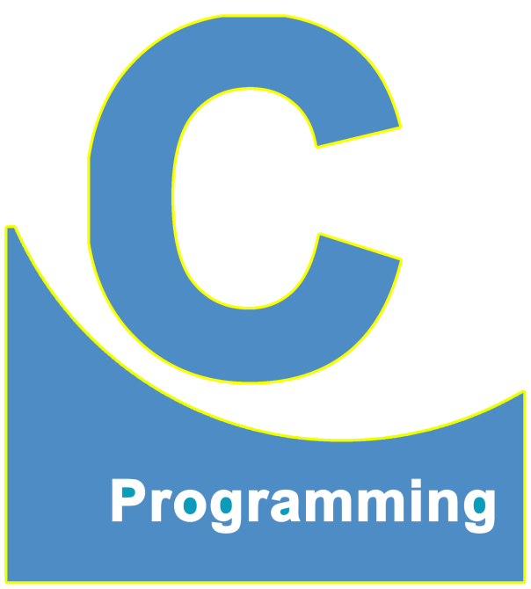
01
02
C Language
Lecture 7
04

Slide 2


Today’s Agenda
01
Important Questions On Escape Sequence
02
Printing Special Character
03
What is Variable ?
04
What is Data Type ?

Slide 3
Important Questions On Escape Sequence
Q 1. We have 5 escape sequences in C, but one of them is very different
from others. Can you name it and explain the difference ?
Answer 1. --------→ \a
This is because all other escape sequences move the cursor to some
different position, but \a doesn’t move the cursor.
Rather is simply generates a beep sound

Slide 4
Important Questions On Escape Sequence
Q 2. Why this topic is called ESCAPE SEQUENCE ?
Answer 2.
They are called ESCAPE SEQUENCE because the function printf() does not
display them on screen while generating the output.
That is, the function printf() escapes them.

Slide 5
Printing Special Character
Can you write a C program to display your name in double quotes ?
Console Window
Like This
“Sachin”

Slide 6
Printing Special Character
Solution :
If you want to display double quotes in the console window, then just
Prefix that double quote with a \
For Example : \” ------→ Double quote will be printed.

Slide 7
Printing Special Character
Console Window
#include <stdio.h>
#include <conio.h>
void main()
{
clrscr();
printf(“\”Sachin\””);
getch();
}
“Sachin”
start
end

Slide 8
Printing Special Character
How will you display a backslash ( \ ) on screen ?
Solution :
If you want to display backslash in the console window, then just
Prefix that backslash with a \
For Example : printf(“ \\ ”); ------→ Backslash will be printed.

Slide 9
What is Variable ?
What is Variable ?
Variable in programming , just like maths are a mechanism, used by
Programmers for storing the value/data
How do we declare a variable ?
Every programming language has own way (syntax) of declaring variable.
For C/C++/Java, we have the following syntax used for variable creation:

Slide 10
What is Data Type ?
<data type> <var_name>;
A data type is an attribute of data which tells the compiler how the
programmer intends to use the data
For Example :
For Integer : int
Real : float
Character : char
Where <var_name> is any alphabet name
These are called keywords.

Slide 11
What is Data Type ?
Q. What is this line doing?
#include <stdio.h>
#include <conio.h>
void main()
{
int a;
……..
……..
}
Ans. This line is declaring an int
type variable
Q. What effect this line will have
on RAM ?
Ans. As soon as this line will run
it will occupy a space of
2B in RAM

Slide 12
Logical Structure of RAM
Logical Structure of RAM
cell
0
1
2
3
4
Addresses
(allocation by O.S)
Total no of cell or
Total no. of byte
N-1

Slide 13
Logical Structure of RAM
=
1 cell = 8 bit
8 bit = 1 Byte
1 Byte = 1 alphabet
1024 B = 1 KB
1024 KB = 1 MB
1024 MB = 1 GB
1024 GB = 1 TB

Slide 14
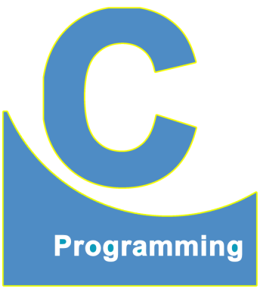
End of Lecture 7
For any queries mail us @: scalive4u@gmail.com
Call us @ : 0755-4271659, 7879165533
Thank you

